Slide 1
AWS- Cloud Computing
Bridge Technologies

Slide 2
What Is Cloud Computing?
Cloud computing is the on-demand delivery of IT resources over the internet with pay-as- you-go pricing.
These resources include tools and applications like data storage, servers, databases, networking, and software
One type of cloud service would be streaming platforms for audio or video, where the actual media files are stored remotely.
Another would be data storage platforms like Google Drive, Dropbox, OneDrive.

Slide 3
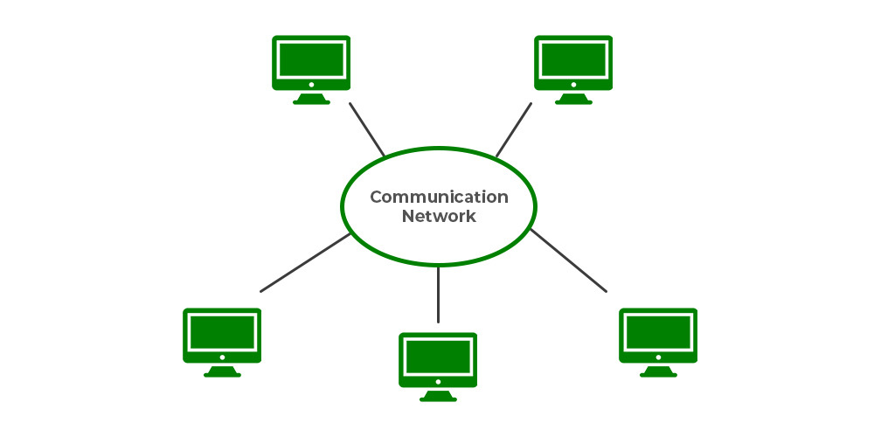
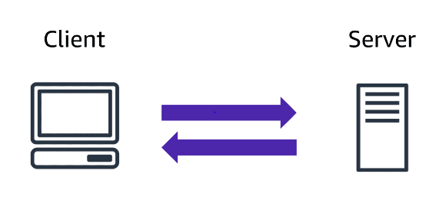
History of Cloud Computing
Before cloud computing emerged, there was client/server computing, centralized storage in which all the data, software applications and all the controls reside on the server side.
Distributed computing concept came after this, where all the computers are networked together and resources are shared when needed
The Cloud Computing concept came into the picture in the year 1950 with accessible via thin/static clients and the implementation of mainframe computers

Slide 4
History of Cloud Computing
Then in 1961, John McCarthy delivered a speech at MIT in which he suggested that computing can be sold like a utility like electricity and food.
In 1999, Salesforce.com became the 1st company to enter the cloud arena, excelling the concept of providing enterprise-level applications to end users through the Internet
Then in 2002, Amazon came up with Amazon Web Services, providing services like computation, storage, and even human intelligence

Slide 6
Benefits of cloud computing
No Trade upfront expense for variable expense : Upfront expense refers to data centers, physical servers, and other resources that you would need to invest in before using them
Stop spending money to run and maintain data centers: Computing in data centers often requires you to spend more money and time managing infrastructure and servers.
cloud computing is the ability to focus less on these tasks and more on your applications and customers
Stop guessing capacity: With cloud computing, you don’t have to predict how much infrastructure capacity you will need before deploying an application.
Increase speed and agility: The flexibility of cloud computing makes it easier for you to develop and deploy applications
Go global in minutes: This means that even if you are located in a different part of the world than your customers, customers are able to access your applications with minimal delays.

Slide 7
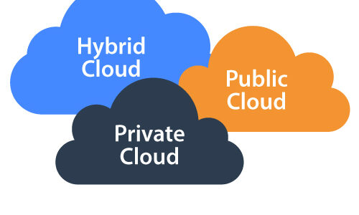
Deployment models
Types of deployment models are
Cloud- Based Deployment – Public , Private
On-Premises Deployment
Hybrid Deployment

Slide 8
Cloud Based Deployment
Run all parts of the application in the cloud.
Design and build new applications in the cloud.
In a cloud-based deployment model, you can migrate existing applications to the cloud, or you can design and build new applications in the cloud.
You can build those applications on low-level infrastructure that requires your IT staff to manage them.
Alternatively, you can build them using higher-level services that reduce the management, architecting, and scaling requirements of the core infrastructure.
For example, a company might create an application consisting of virtual servers, databases, and networking components that are fully based in the cloud.

Slide 9
Public vs Private

Slide 10
On-Premises Deployment
Deploy resources by using virtualization and resource management tools.
Increase resource utilization by using application management and virtualization technologies.
On-premises deployment is also known as a private cloud deployment. In this model, resources are deployed on premises by using virtualization and resource management tools. For example, you might have applications that run on technology that is fully kept in your on-premises data center. Though this model is much like legacy IT infrastructure, its incorporation of application management and virtualization technologies helps to increase resource utilization.

Slide 11
Hybrid Deployment
Connect cloud-based resources to on-premises infrastructure.
Integrate cloud-based resources with legacy IT applications.
In a hybrid deployment, cloud-based resources are connected to on-premises infrastructure.
you have legacy applications that are better maintained on premises, or government regulations require your business to keep certain records on premises.

Slide 12
Cloud Service Model

Slide 13
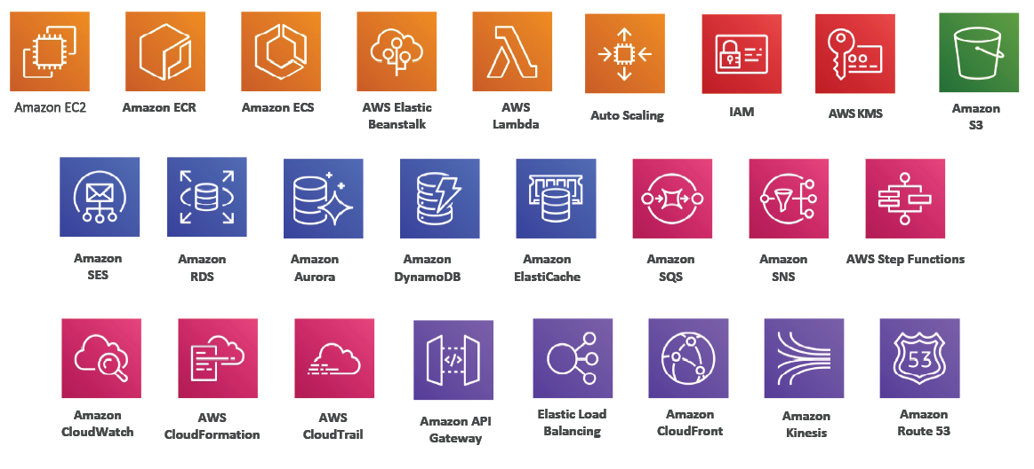
What is AWS?
AWS (Amazon Web Service) is a Cloud Provider.
AWS provides with servers and services with scalability, Reduced Latency.

Slide 15
AWS
Amazon Web Services (AWS) is the largest cloud computing platform, offering 200+ universally featured resources, from infrastructure to machine learning.
These combinable systems provide maximum usability and are designed expressly for the optimization of your application’s performance through content delivery features, data storage, and more.
Amazon hosts global data centers with a vast network ensuring reduced latency worldwide.

Slide 16
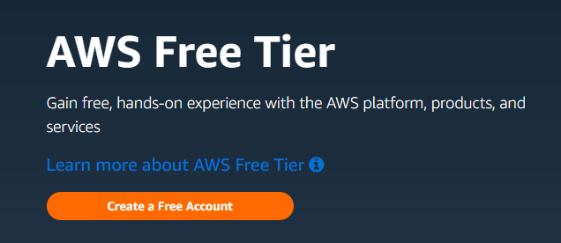
AWS Free-Tier Account - Creation
Navigate to https://aws.amazon.com/free
Click on “Create Free Account”
Enter Email id & Aws Account Name

Slide 17
AWS Free-Tier Account - Configuration

Slide 18
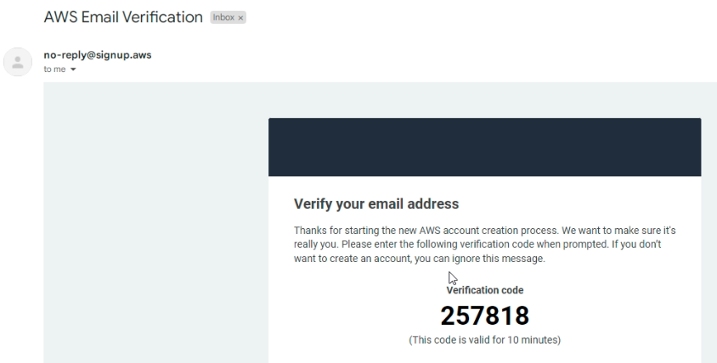
AWS Free-Tier Account - Verification
Verify Email Address

Slide 19
AWS Free-Tier Account – Validation

Slide 20
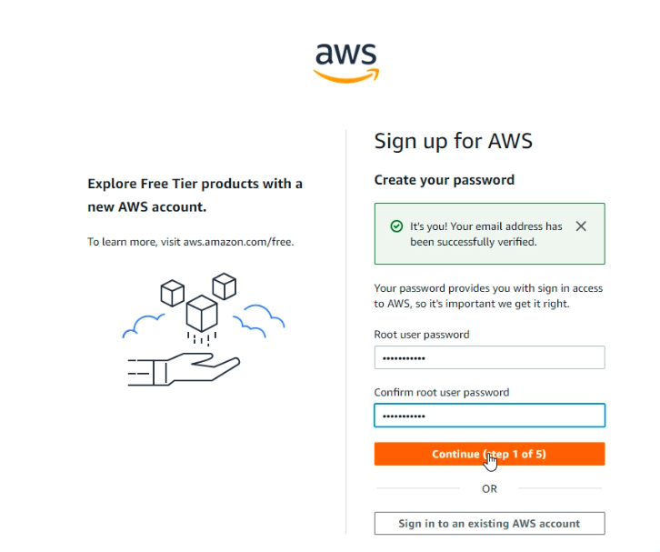
AWS Free-Tier Account - Password
Create your password

Slide 21
AWS Free Tier- Contact Information

Slide 22
AWS Free-Tier Account – Card Information

Slide 23
AWS Free-Tier Account Identity Confirmation

Slide 24
AWS Free-Tier Account- Confirm Identity

Slide 25
AWS Free-Tier Account

Slide 26
Login to AWS Free-Tier Account

Slide 27
Accessing AWS Account
To access AWS, you have three options:
AWS Management Console (protected by password + MFA)
AWS Command Line Interface (CLI): protected by access keys
AWS Software Developer Kit (SDK) - for code: protected by access keys
Access Keys are generated through the AWS Console
Users manage their own access keys
Access Keys are secret, just like a password. Don’t share them

Slide 28
AWS Global Infrastructure
https://aws.amazon.com/about-aws/global-infrastructure/regions_az/
AWS Regions
AWS Availability Zones
AWS Edge Location/ Point of Presence

Slide 29
How to Choose Region?
Compliance with data governance and legal requirements: data never leaves a region without your explicit permission
Proximity to customers: reduced latency
Available services within a Region: new services and new features aren’t available in every Region
Pricing: pricing varies region to region and is transparent in the service pricing page

Slide 30
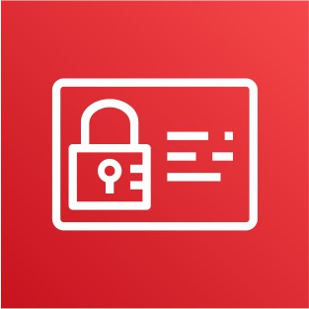
Identity and Access Management (IAM)
Users & Groups
IAM = Identity and Access Management, Global service
Root account created by default, shouldn’t be used or shared
Users are people within your organization, and can be grouped
Groups only contain users, not other groups
Users don’t have to belong to a group, and user can belong to multiple groups

Slide 31
IAM Permissions, Policy Inheritence & Password Policy
Users or Groups can be assigned JSON documents called policies - Policy Generator
These policies define the permissions of the users
In AWS you apply the least privilege principle: don’t give more permissions than a user needs
Password Policy:
Set a minimum password length
Require specific character types:
including uppercase letters
lowercase letters
numbers
non-alphanumeric characters
Allow all IAM users to change their own passwords
Require users to change their password after some time (password expiration)
Prevent password re-use

Slide 32
Multi Factor Authentication
Users have access to your account and can possibly change configurations or delete resources in your AWS account
You want to protect your Root Accounts and IAM users
MFA = password you know + security device you own

Slide 33
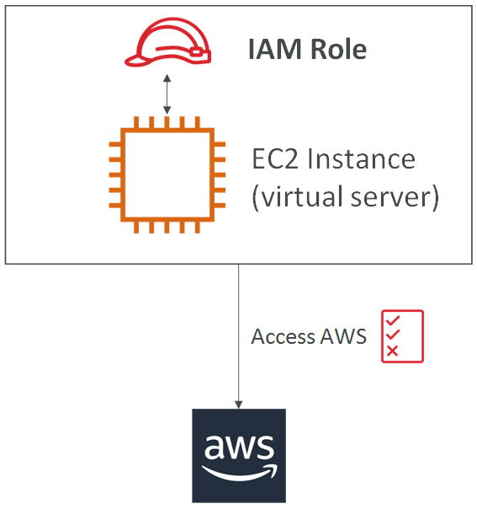
IAM Roles
Some AWS service will need to perform actions on your behalf
Common roles:
EC2 Instance Roles
Lambda Function Roles
Roles for CloudFormation

Slide 34
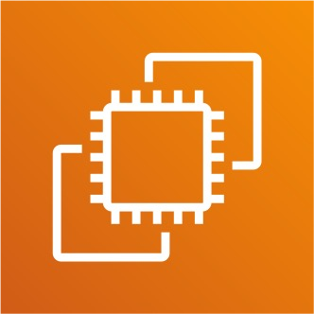
AWS EC2 Elastic Compute Cloud

